Slide 1
Università degli Studi di Modena e Reggio Emilia UNIMORE
Challenges and Future Opportunities of Hairpin Technologies
Dipartimento di Ingegneria "Enzo Ferrari"

Slide 2
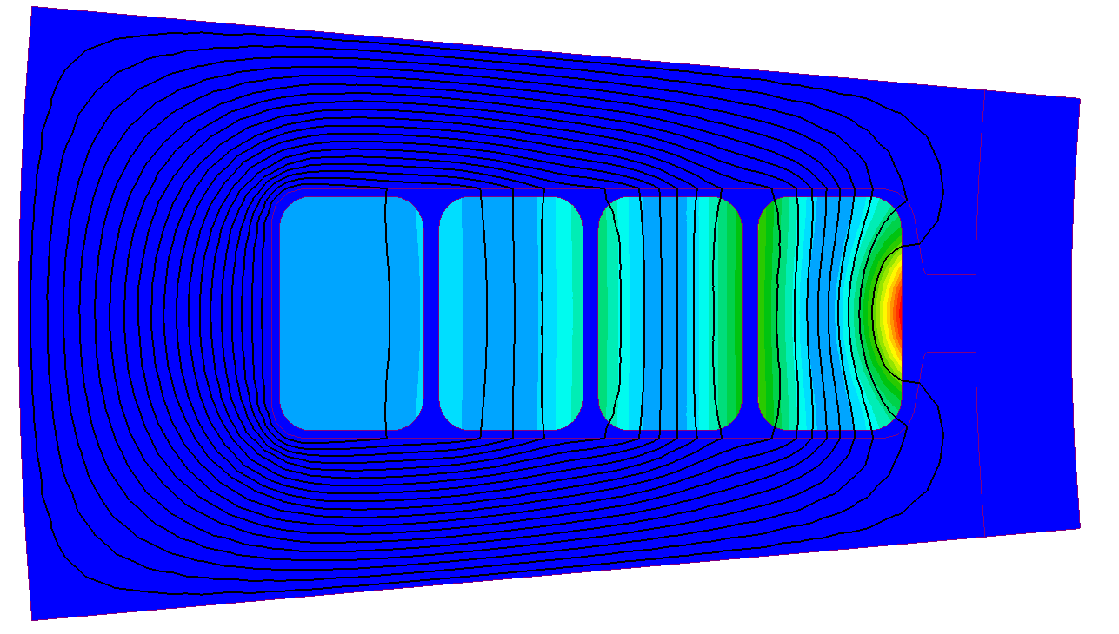
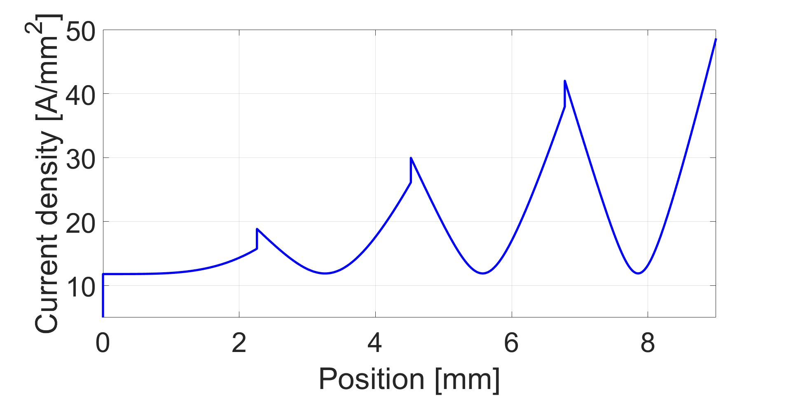
Standard hairpin winding
Conventional hairpin windings are often characterized by high AC losses at medium/high frequencies.

Slide 3
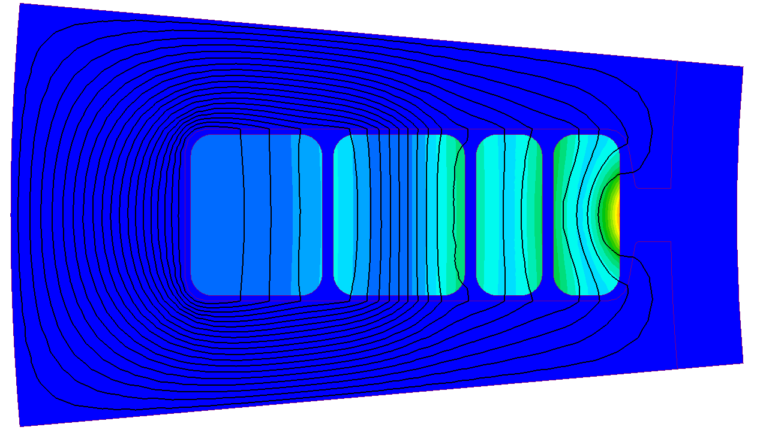
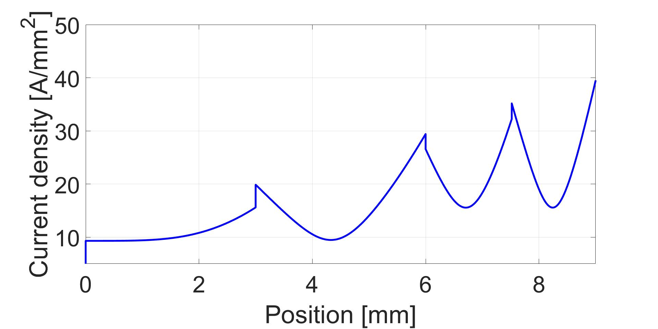
Innovative geometry: asymmetric hairpins
Reducing the sixe of the conductors near the slot opening helps to reduce the current density, i.e. the AC losses within the conductors.

Slide 4
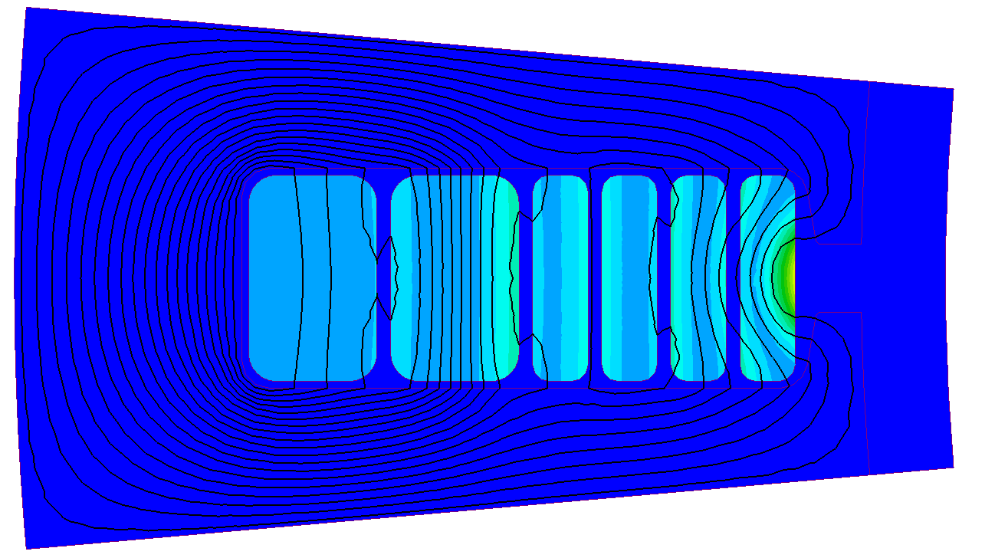
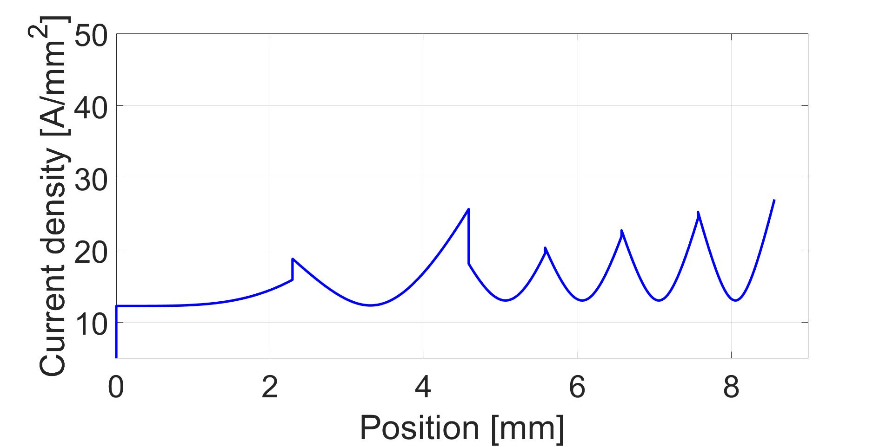
Innovative geometry: segmented hairpins
Another solution is to use parallel paths inside the slots.
In this way, the current density is further reduced.

Slide 5
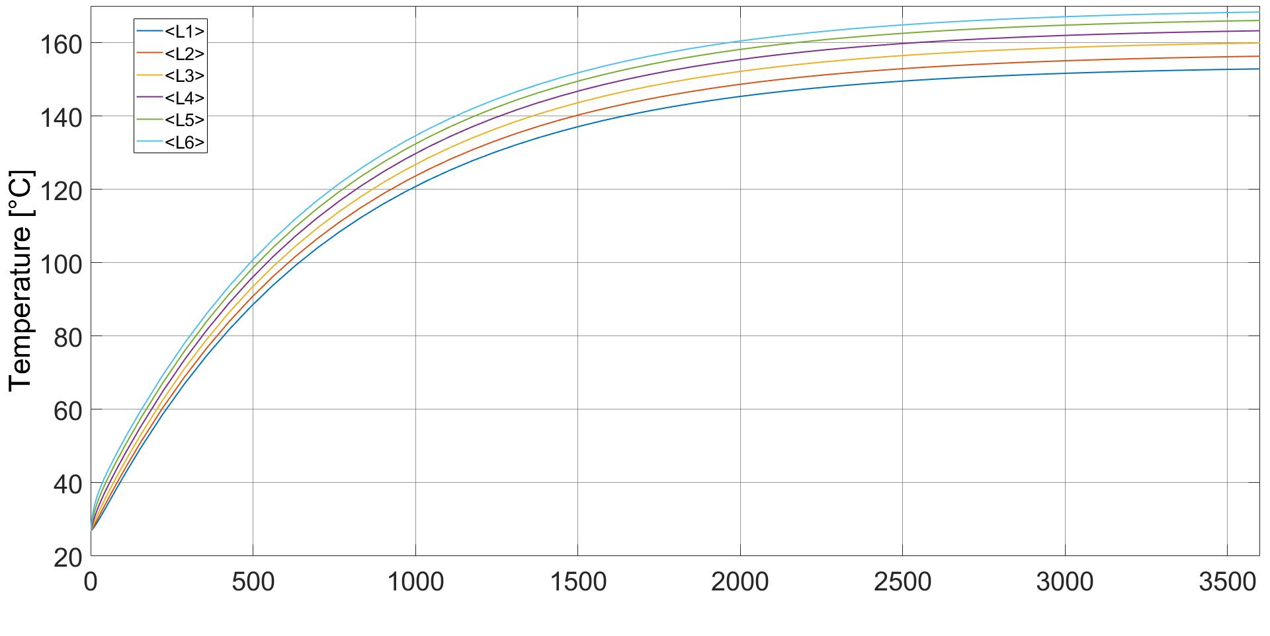
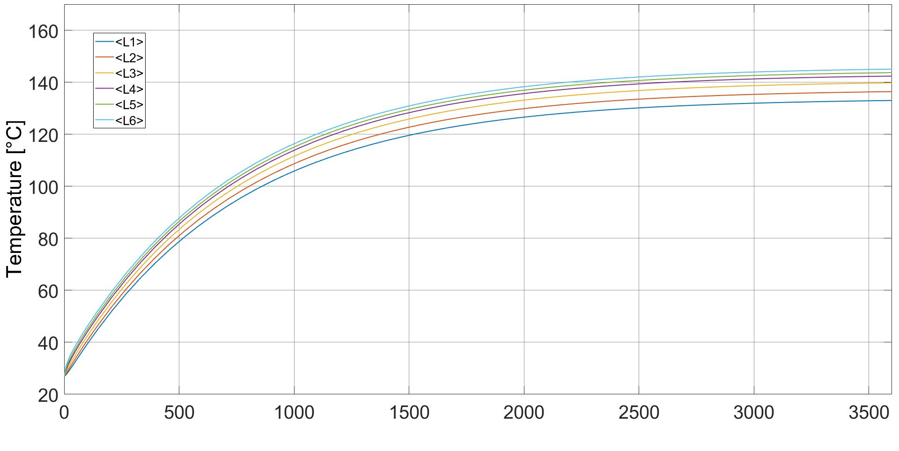
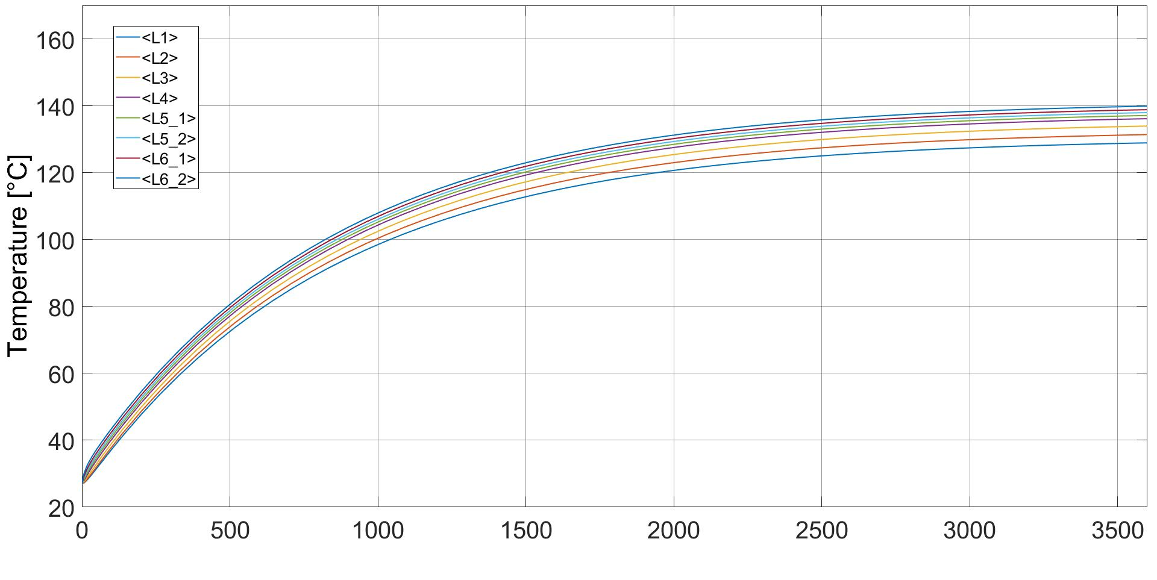
Thermal improvement
As a consequence, the loss reduction also affects the operative temperatures of the motor.
Conventional
TMAX=169°C
Asymmetric
TMAX=145°C
Segmented
TMAX=139°C

